Slide 1
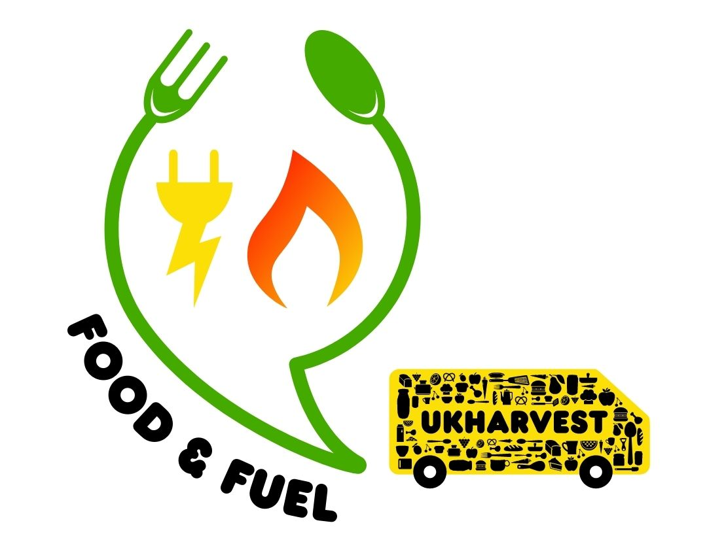
Sustainable Food
Food Miles

Slide 2
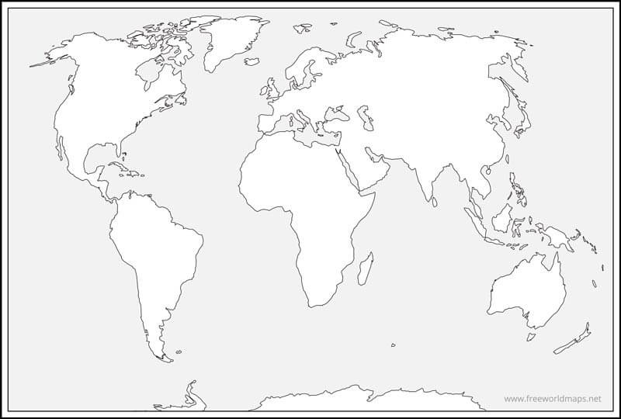

Where Does Our Food Come From

Slide 3
The Field To Fork Journey
Farming -
Where the crops are grown or the meat is reared
Factory -
Packaging, Meal Production or Cleaning
Storage -
Food stored correctly and sorted/picked for transportation
Transport -
Getting the food product to retail by air, land or sea
Retail -
Where the food is sold to the consumer
Your Plate -
Prepared and served for us to consume yummy

Slide 4
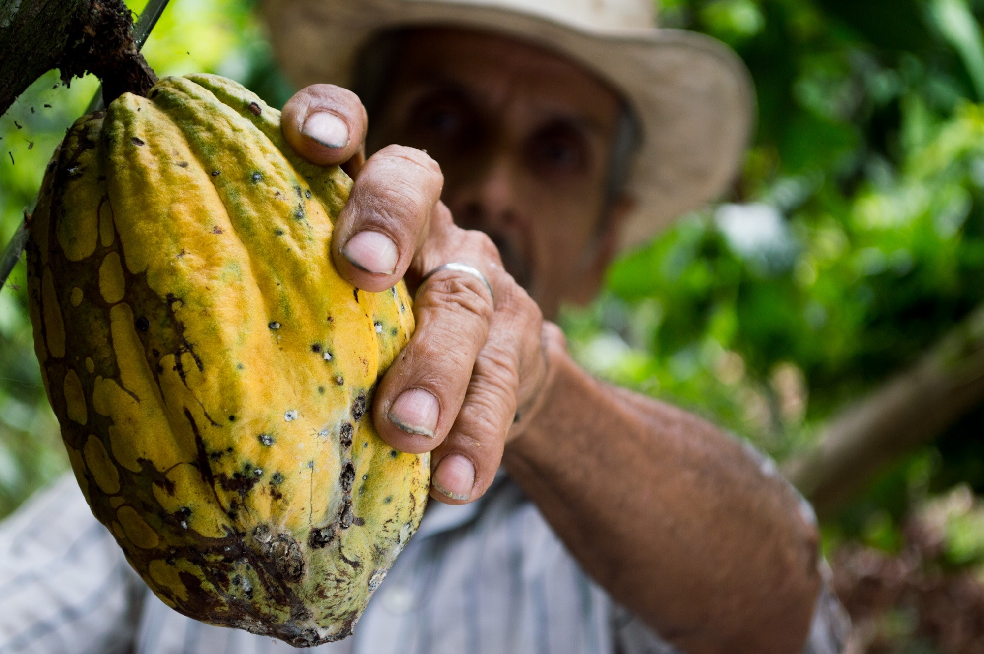
Farming – Where the crops are grown or the meat is reared

Slide 5
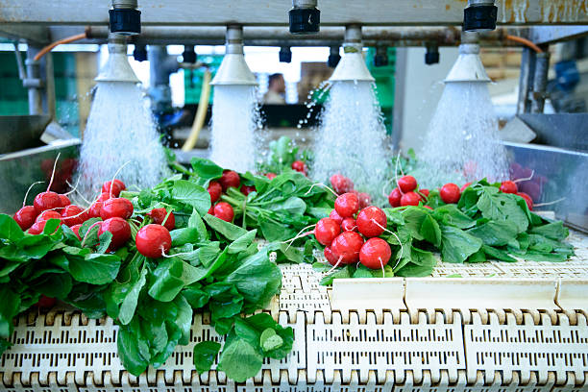
Factory – Packaging, Meal Production or Cleaning

Slide 6
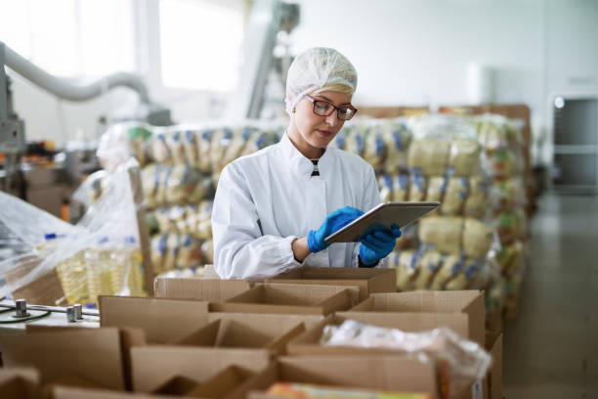
Storage – Stored, Sorted and Packed For Distribution

Slide 7
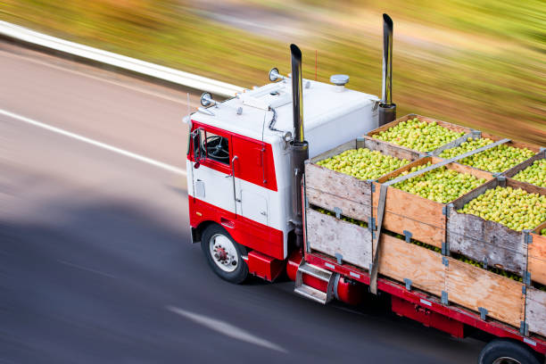
Transport – Food to Retail by Air, Land and Sea

Slide 8
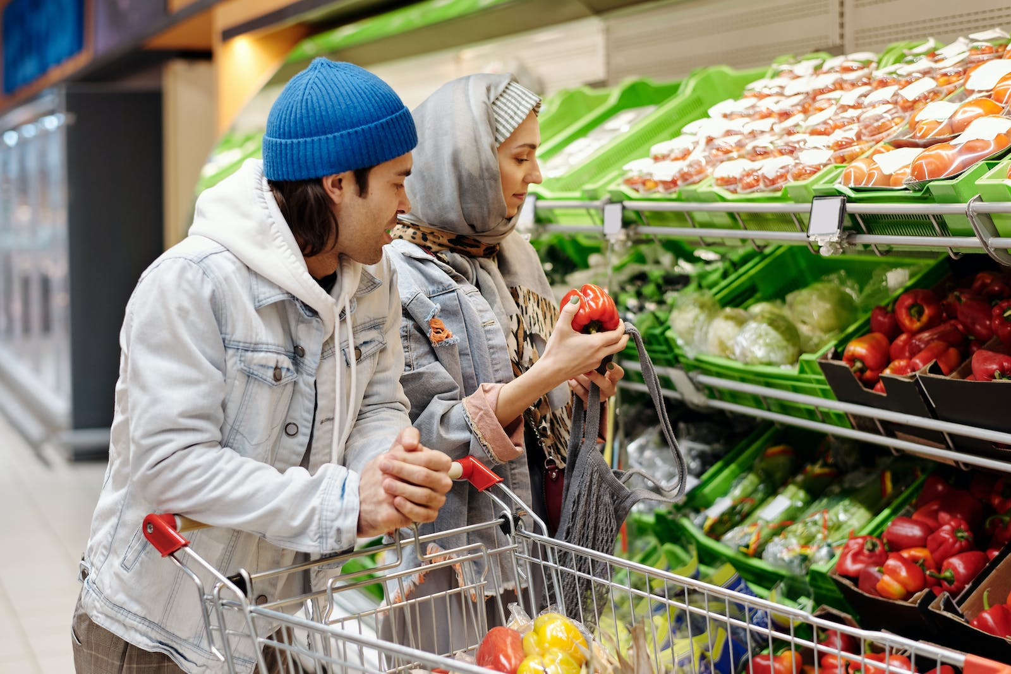
Retail – Where Food is Sold

Slide 9
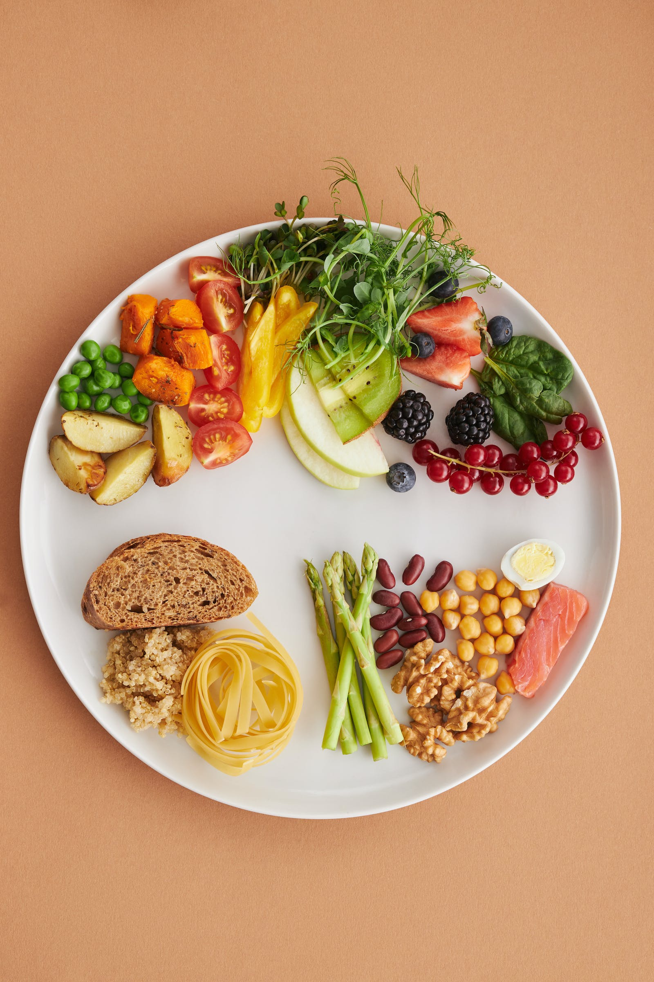
Your Plate - Yummy

Slide 10
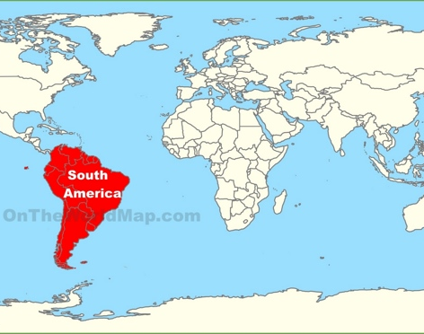
The Banana Journey
World leading exports of banana’s come from tropical regions and include Central and South America and the Philippines, with over 90% of exports originating in these areas.⁽ Bananas | FAO | Food and Agriculture Organization of the United Nations)

Slide 11
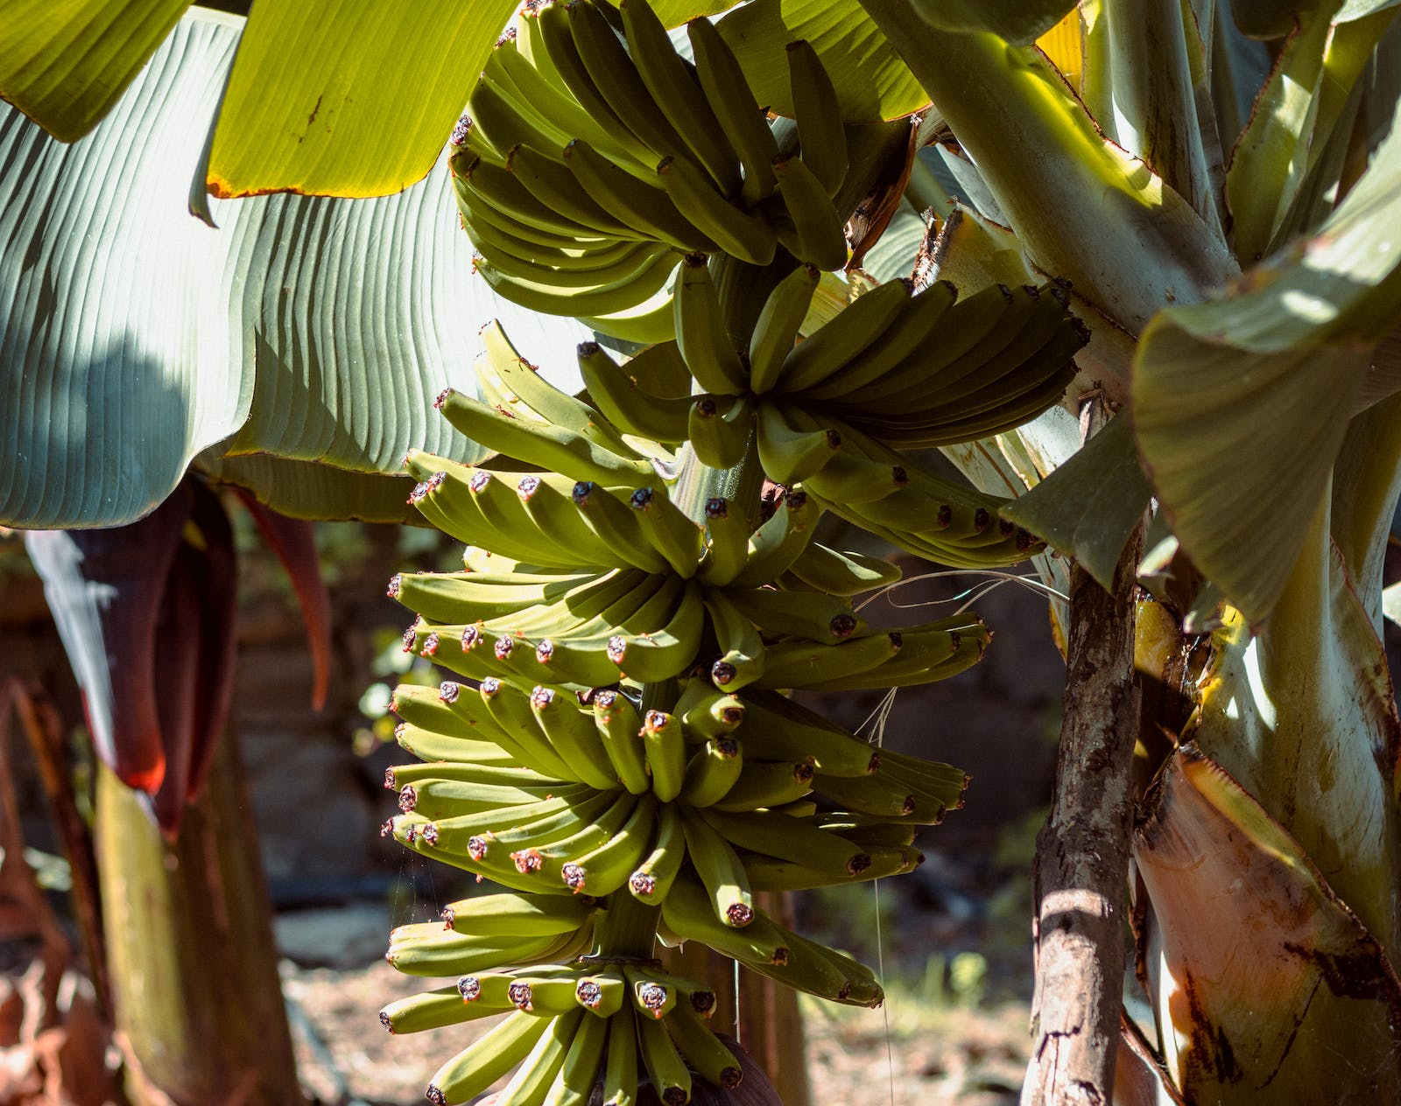
Farming and Factory
Bananas are grown on trees in hot countries (above 27 degrees Celsius)
They take 9 – 12 months to grow
Big bunches are carried or transported to a factory for cleaning and cutting

Slide 12
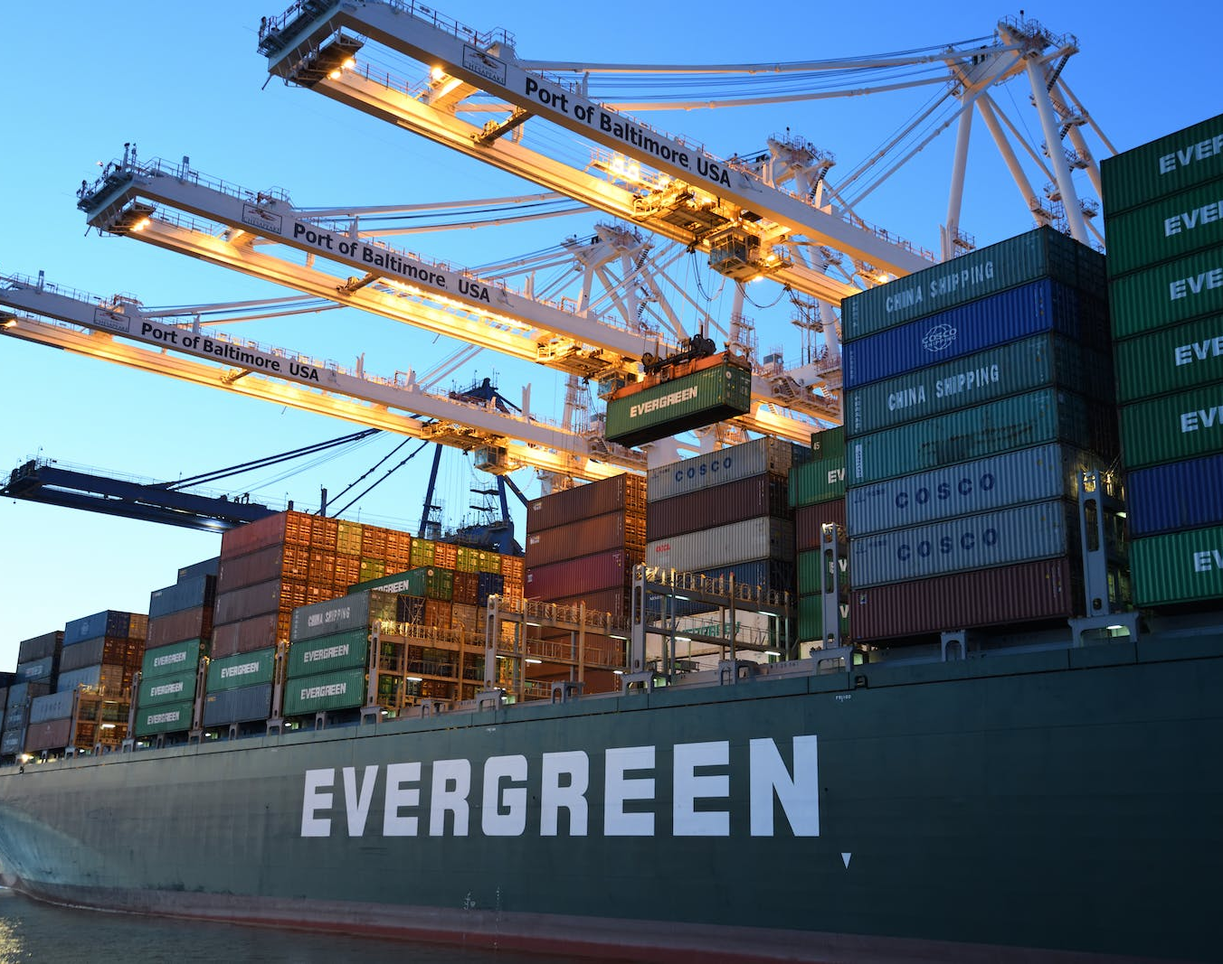
Storage and Transport
Bananas are stored in a refrigerator to stop them ripening quickly
The ships from Central America take 6 – 12 days to get to the UK

Slide 13
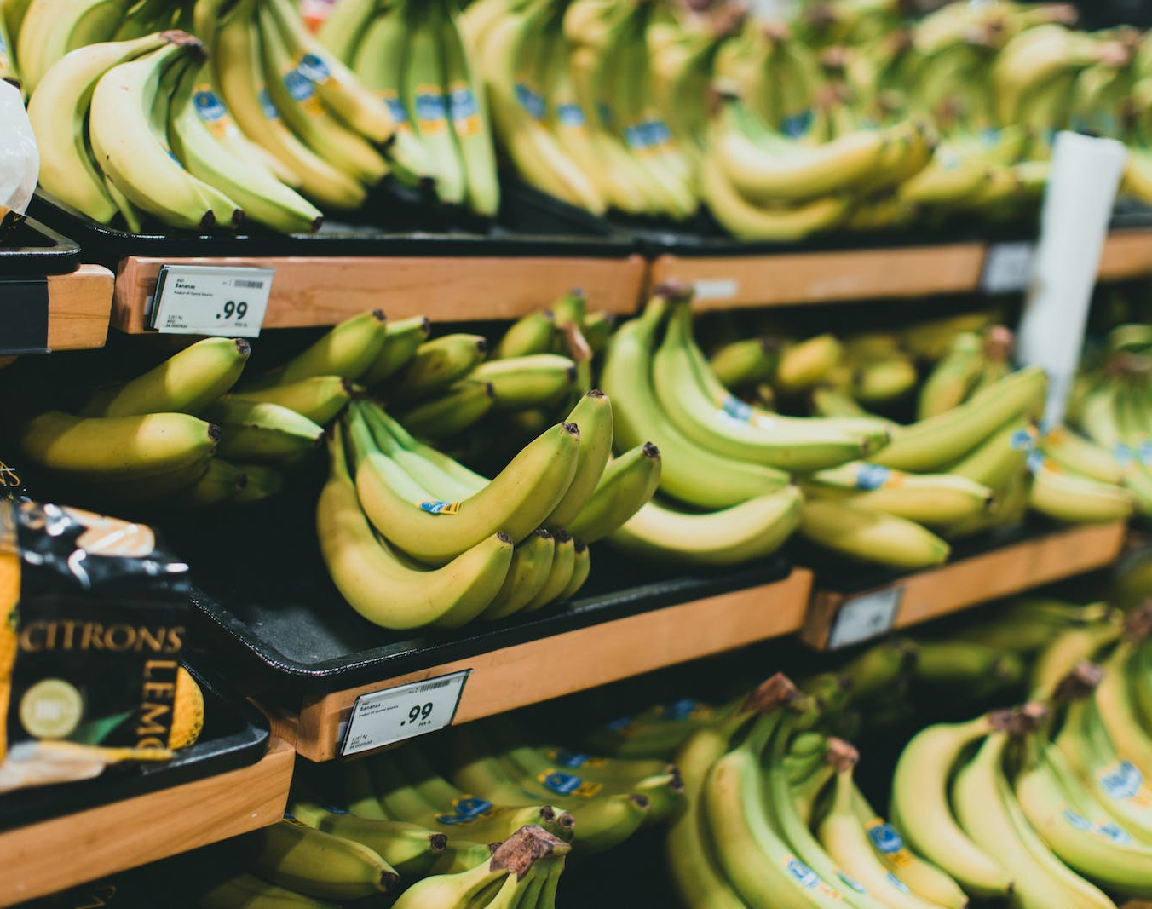
Retail and Eating
Fruit in our shops and ready to eat at home.

Slide 14
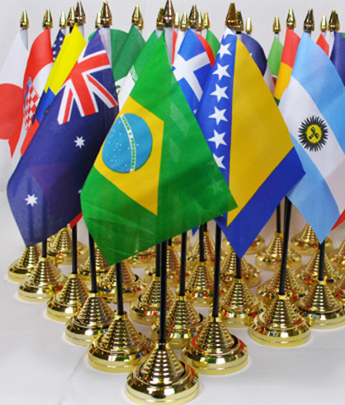
How far has your food travelled?
What do you eat?
What are the ingredients for 1 meal?
Where did each ingredient come from?
How many miles has that product travelled?
What is the total milage for your meal?

Slide 15

Where in the World?
Collect empty food packets or labels for food that your household has bought.
Look at the country of origin for these products and mark them on the world map.
Which product travelled furthest?

Slide 16
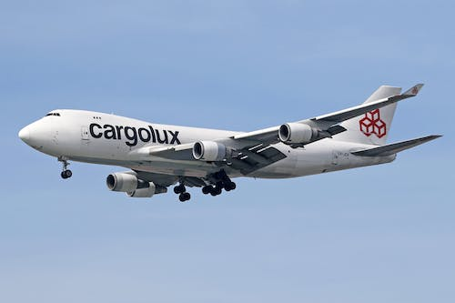
What Impact Does Transport Have

Slide 17
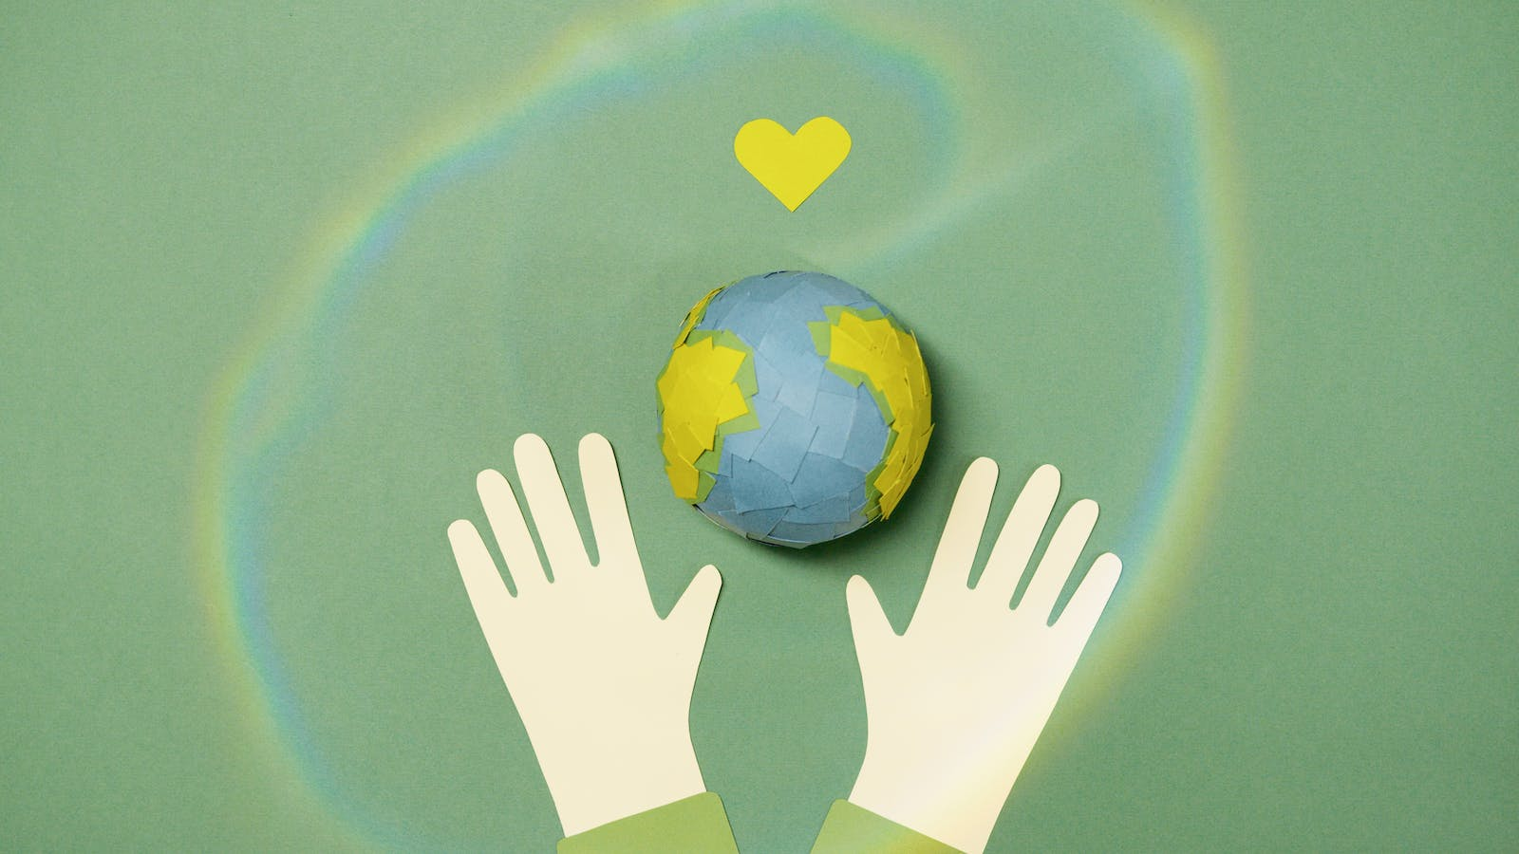
What Impact Does Transport Have
Greenhouse Gas Emissions
Air Pollution and Health
Accidents/Congestion
Water Pollution
Fossil Fuel Use
Noise

Slide 18
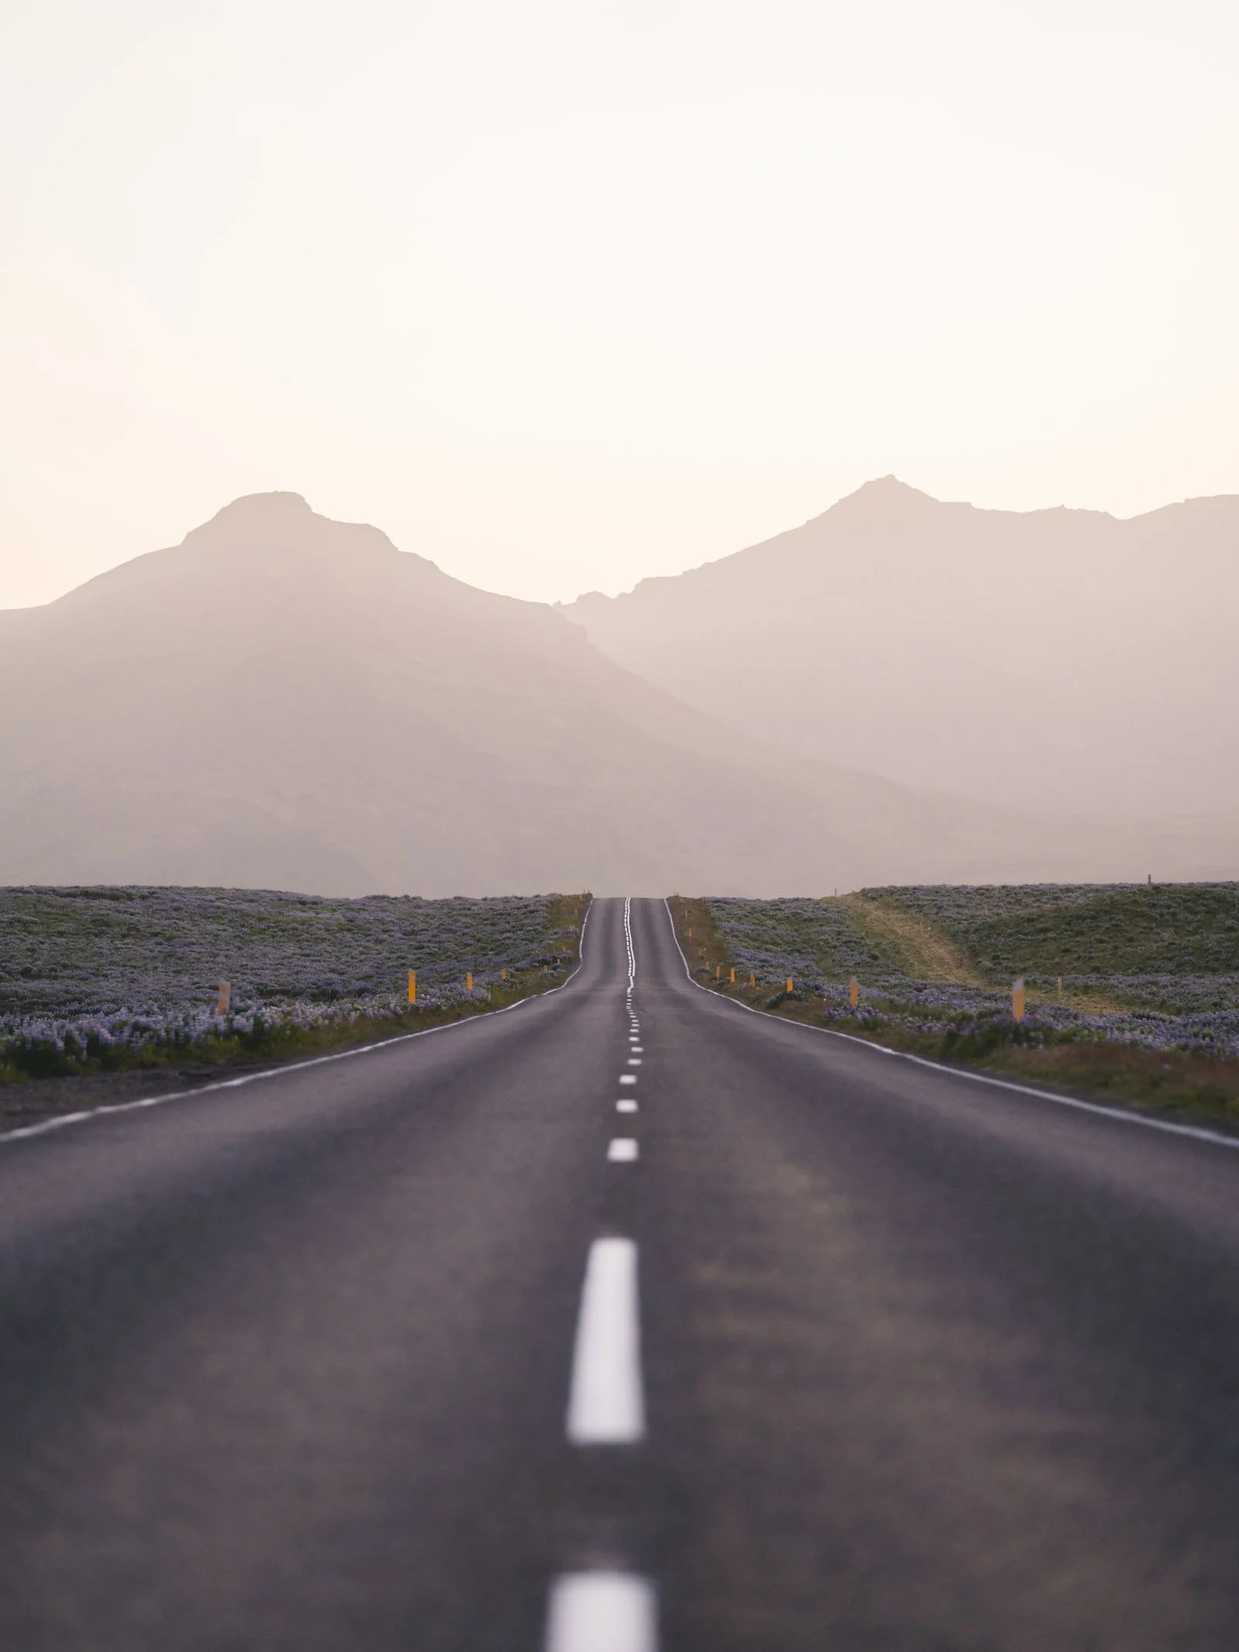
How can we reduce our miles

Slide 19
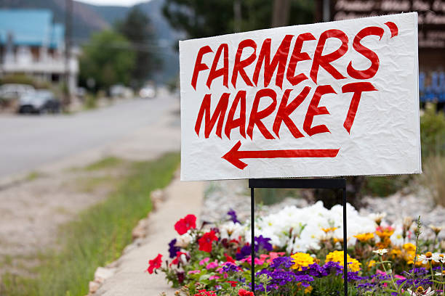
How to Reduce Food Miles
Farmers Markets
Buy British
Green Fingers

Slide 20
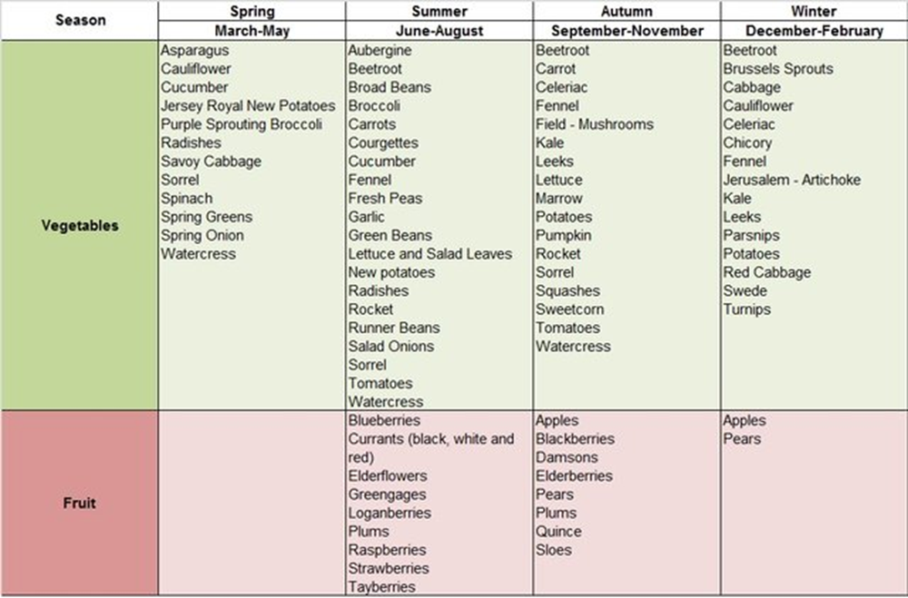
Seasonal Shopping

Slide 21
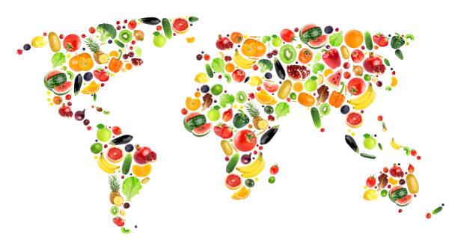
Fruit and Vegetable Travels
Travel the fruit and Vegetable aisle in the supermarket.
Where various fruit and vegetables come from?
Can swapping for a different fruit or vegetable reduce the travel miles?

