Slide 1
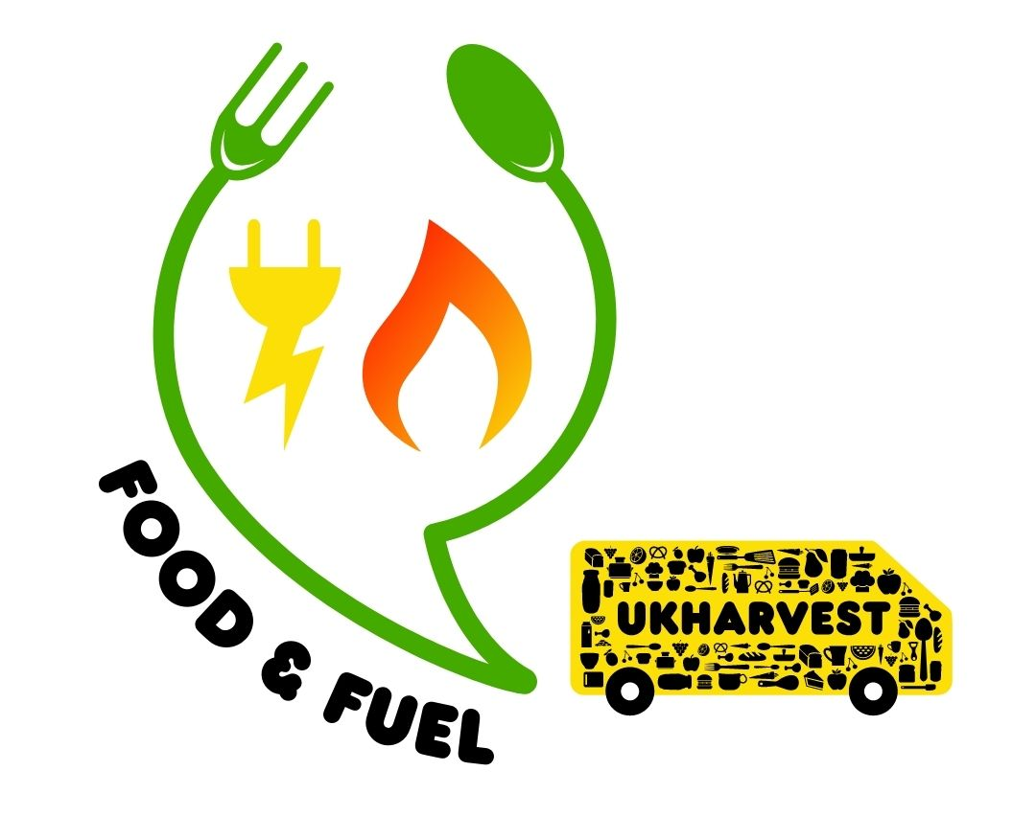
Sustainable Food
Food Security

Slide 2
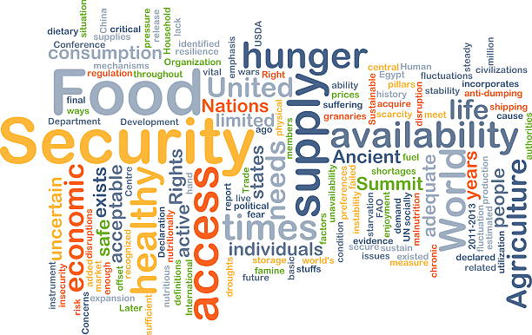

What is the difference between hunger and food insecurity

Slide 3
What is Hunger
Feelings of Discomfort
Feelings of Weakness
Lack of Food
Desire To Eat
Available Solution to Feelings
Hunger!

Slide 4
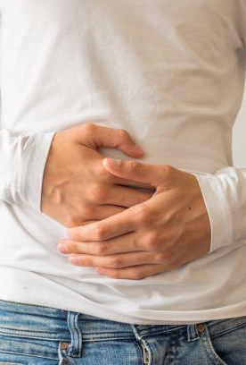
Hungry ….
Hungry is all about feelings –
Discomfort
Weakness
Lack of Food
The Desire to Eat
Feelings can be personal and what 1 person feels could be different to others.

Slide 5
What is Food Insecurity
Lack of Access
Lack of Availability
Lack of Affordability
Lack of Nutrients
No Solution Available
Food Insecurity!

Slide 6

Food Insecurity
Food Insecurity is all about access –
Can a person get to the food?
Can a person afford the food?
Is the food available?
Is the food available nutritious?
Access is measurable for each individual. Blocks to access may be different for everyone, however, if the answers to the above 4 questions is NO then this is food insecurity not hunger.

Slide 7
What causes food insecurity

Slide 8
Main Causes of Global Food Insecurity
Climate Change
Economic Change
Conflict
Population Growth
Access

Slide 9
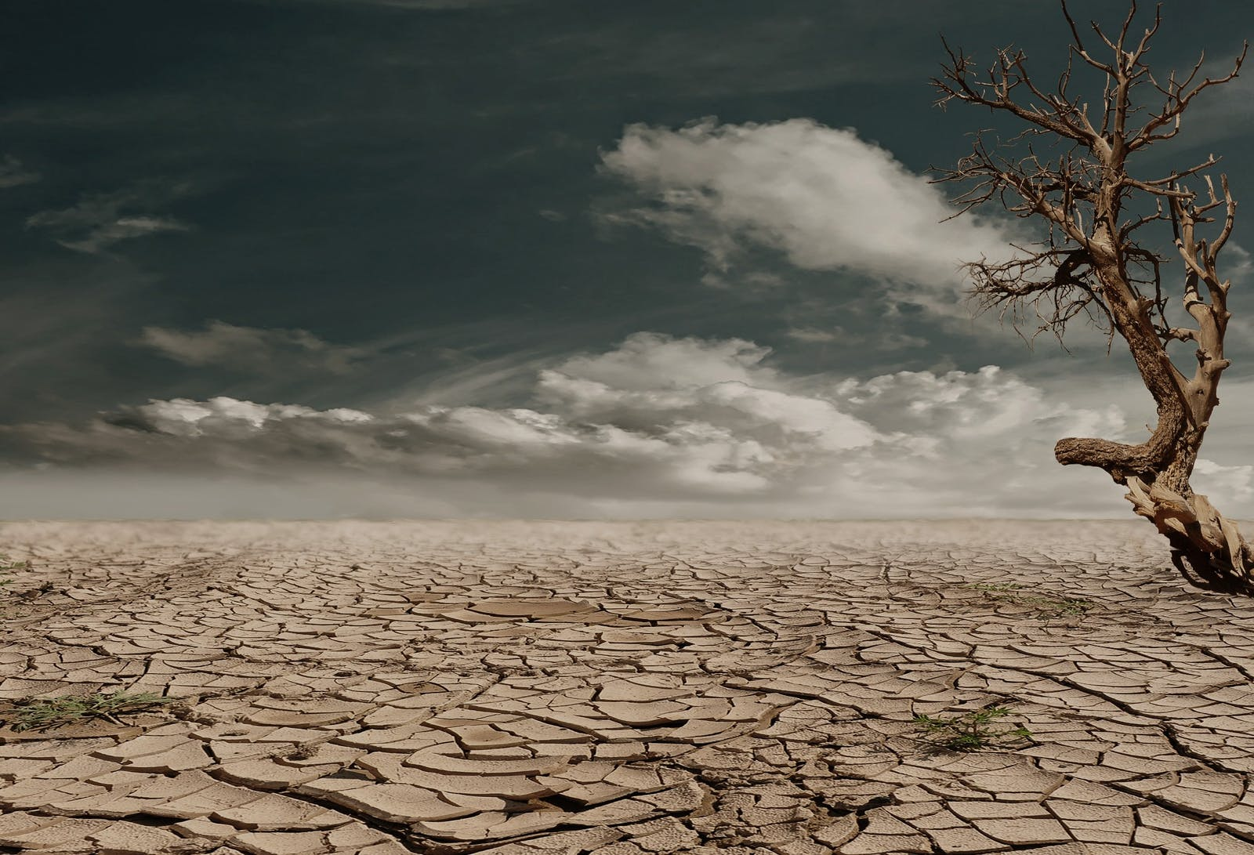
Climate Change
Climate change, especially flooding and drought play a large role in food insecurity.
Where people are responsible for growing or rearing their own food, drought and flooding can cause food insecurity for large numbers of people.

Slide 10

Economic Change
This is not just about household incomes. Several different factors can effect the economics of food insecurity.
If supply amounts of a product becomes smaller but demand to buy stays high the price will rise.

Slide 11

Conflict
Countries at war or suffering civil unrest and disturbance show higher rates of food insecurity. Over 60% of those who are food insecure are living in conflict zones.
Conflict forces people to flee from their homes, often leaving behind their only means to a livelihood.

Slide 12
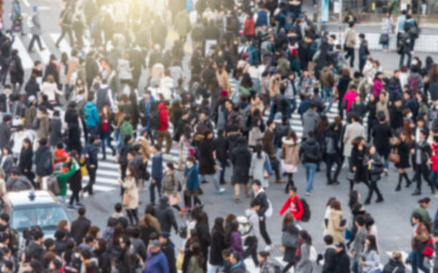
Population Growth
According to the United Nations, the global population will be nearly 10 billion people by 2050.
As the population continues to grow, it is necessary that food production and food accessibility grow to match it.

Slide 13

Access
Direct accessibility to nutritious and affordable food are growing as a cause of food insecurity within the UK.
Some accessibility issues could be lack of food shops offering healthy options or lack of transport to visit supermarkets.
Can you think of any other accessibility blocks to nutritious and affordable food for all?

Slide 14
What can we change to increase food security

Slide 15
What can be done to increase food security and reduce global hunger?
Organic Farming
Fairtrade
Science

Slide 16
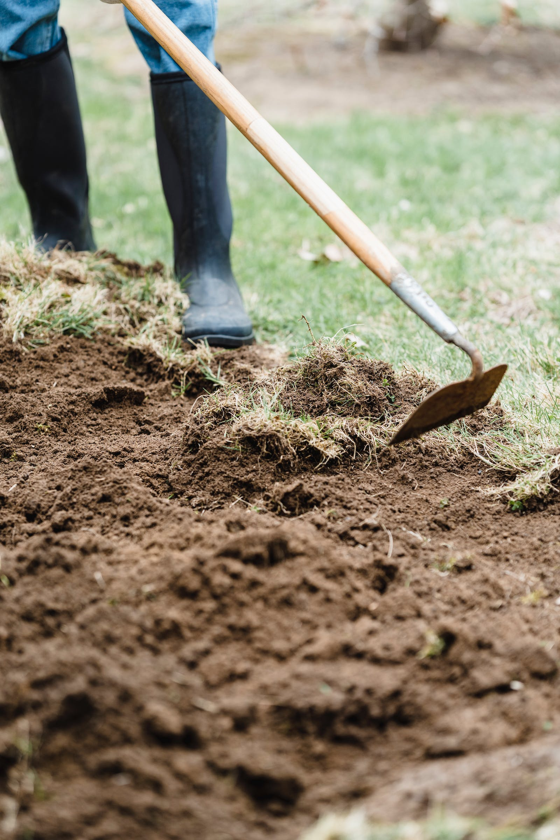
Organic Farming
Organic farming is seen as a healthier and more sustainable way to feed our growing population with a smaller impact on our wider environment.
Organic agriculture generally creates less soil and water pollution and lower greenhouse gas emissions, and is more energy efficient.
Organic agriculture is also associated with greater biodiversity of plants, animals, insects and microbes as well as genetic diversity.

Slide 17

Fairtrade
Fairtrade is all about paying a fair price for the things that we buy.
This will help people become food secure by ensuring that growers receive better prices for their crops, allowing them to support the workforce with better conditions and rates of pay.
Fairtrade products support over 1 million farmers and workers in 74 countries worldwide.
By supporting Fairtrade producers we can directly support people have the money to afford nutritious foods.

Slide 18

Science
Scientific developments will allow for the world to move into a more food secure space.
From crop modification to allow growers to produce food in times of drought, to GPS driven machines to enhance crop yield, science is playing a large role in the movement towards global food security.

Slide 19
Benefits of a food secure nation
Social Impacts
Economic Impacts
Environmental Impacts

Slide 20
Activity
A country is looking at ways that it can increase food security for it’s entire population. You have been asked, as a student ambassador, to identify the positive impacts a food secure population would have on society, economics and the environment.
For each heading describe 5 different positive impacts that food security would have.
Social Impacts
Economic Impacts
Environmental Impacts

